Slide 1
محاضرة10

Slide 2
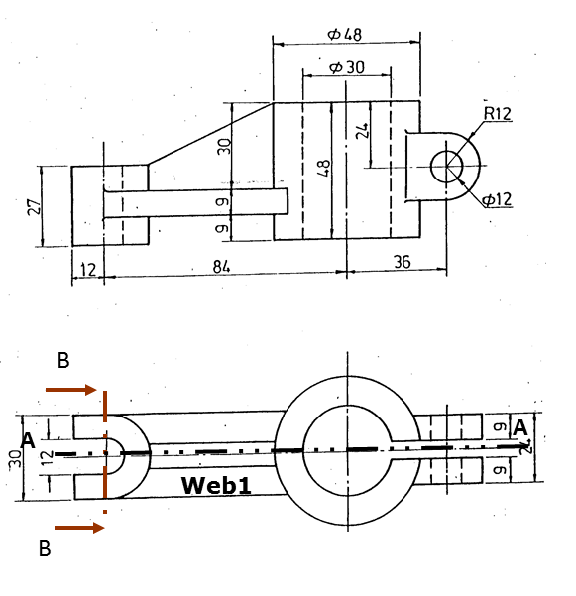
Drawing of a sectional elevation and side view

Slide 3
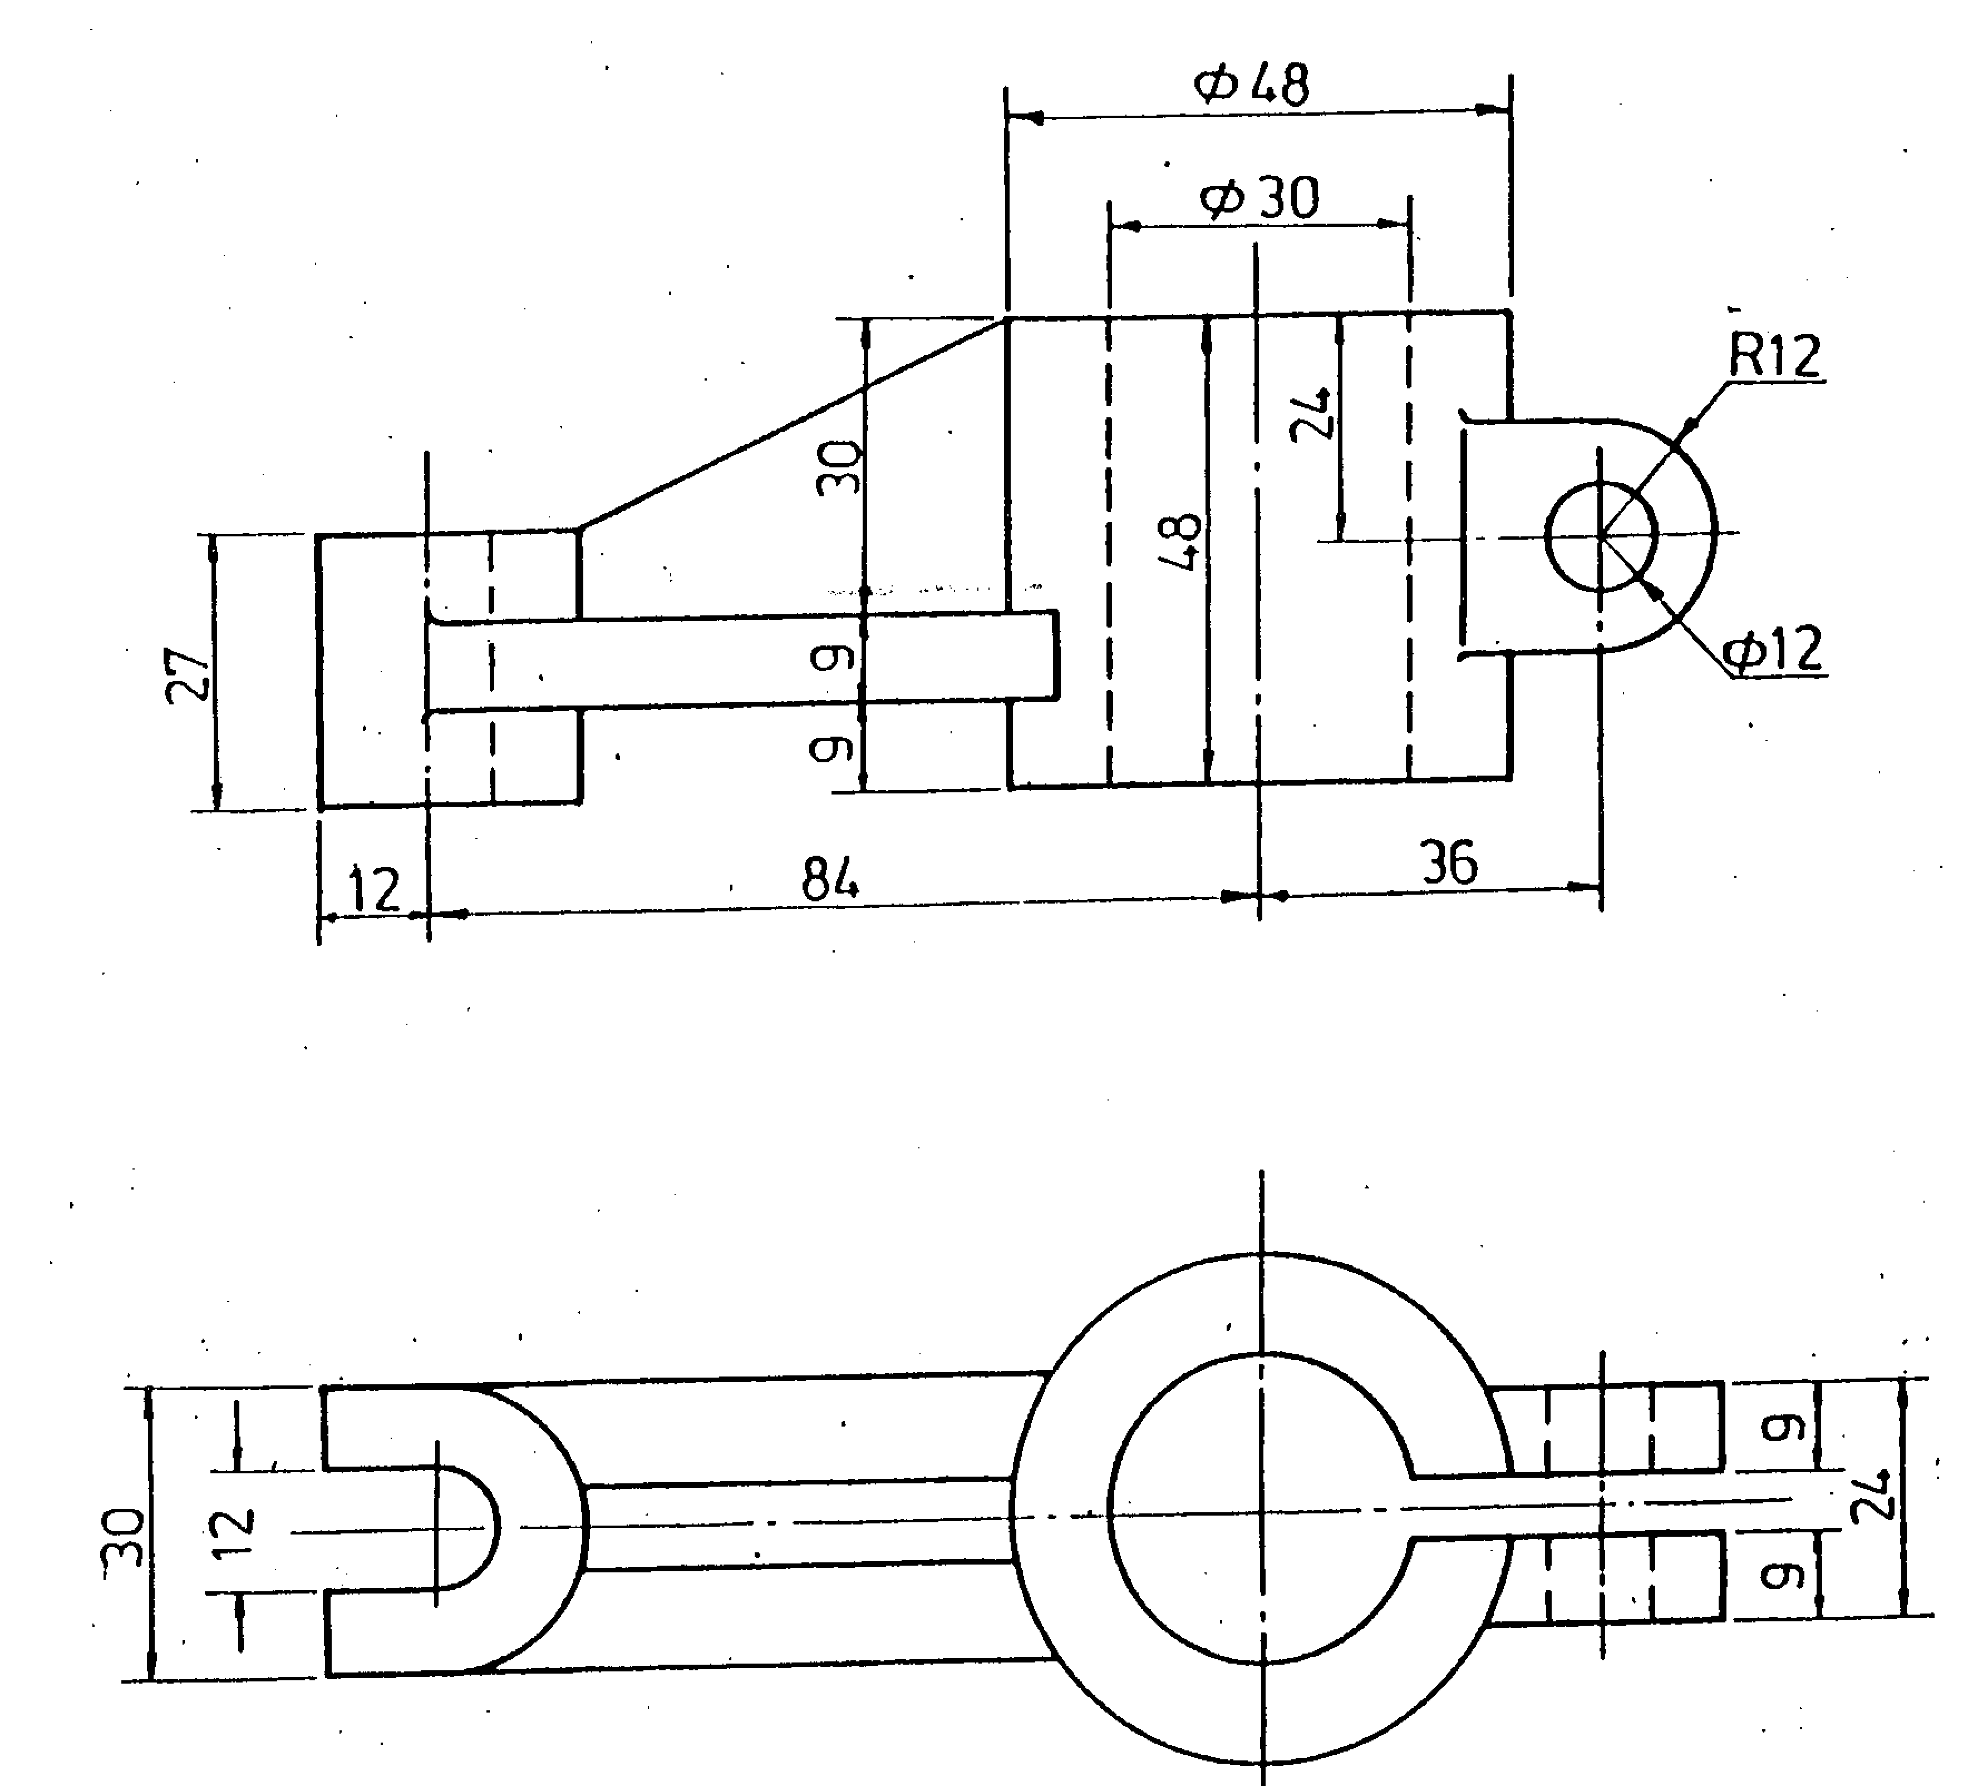
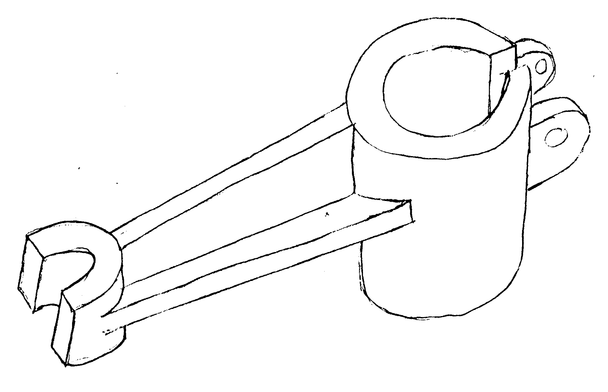
10. Drawing of a sectional elevation and side view
Web2
Cylinder
Web2
Web1
Web1
B
ISOMETRIC
A
A
Web2
Web1
B
Prof. Dr. Mohamed Omar Mousa March 2006

Slide 4
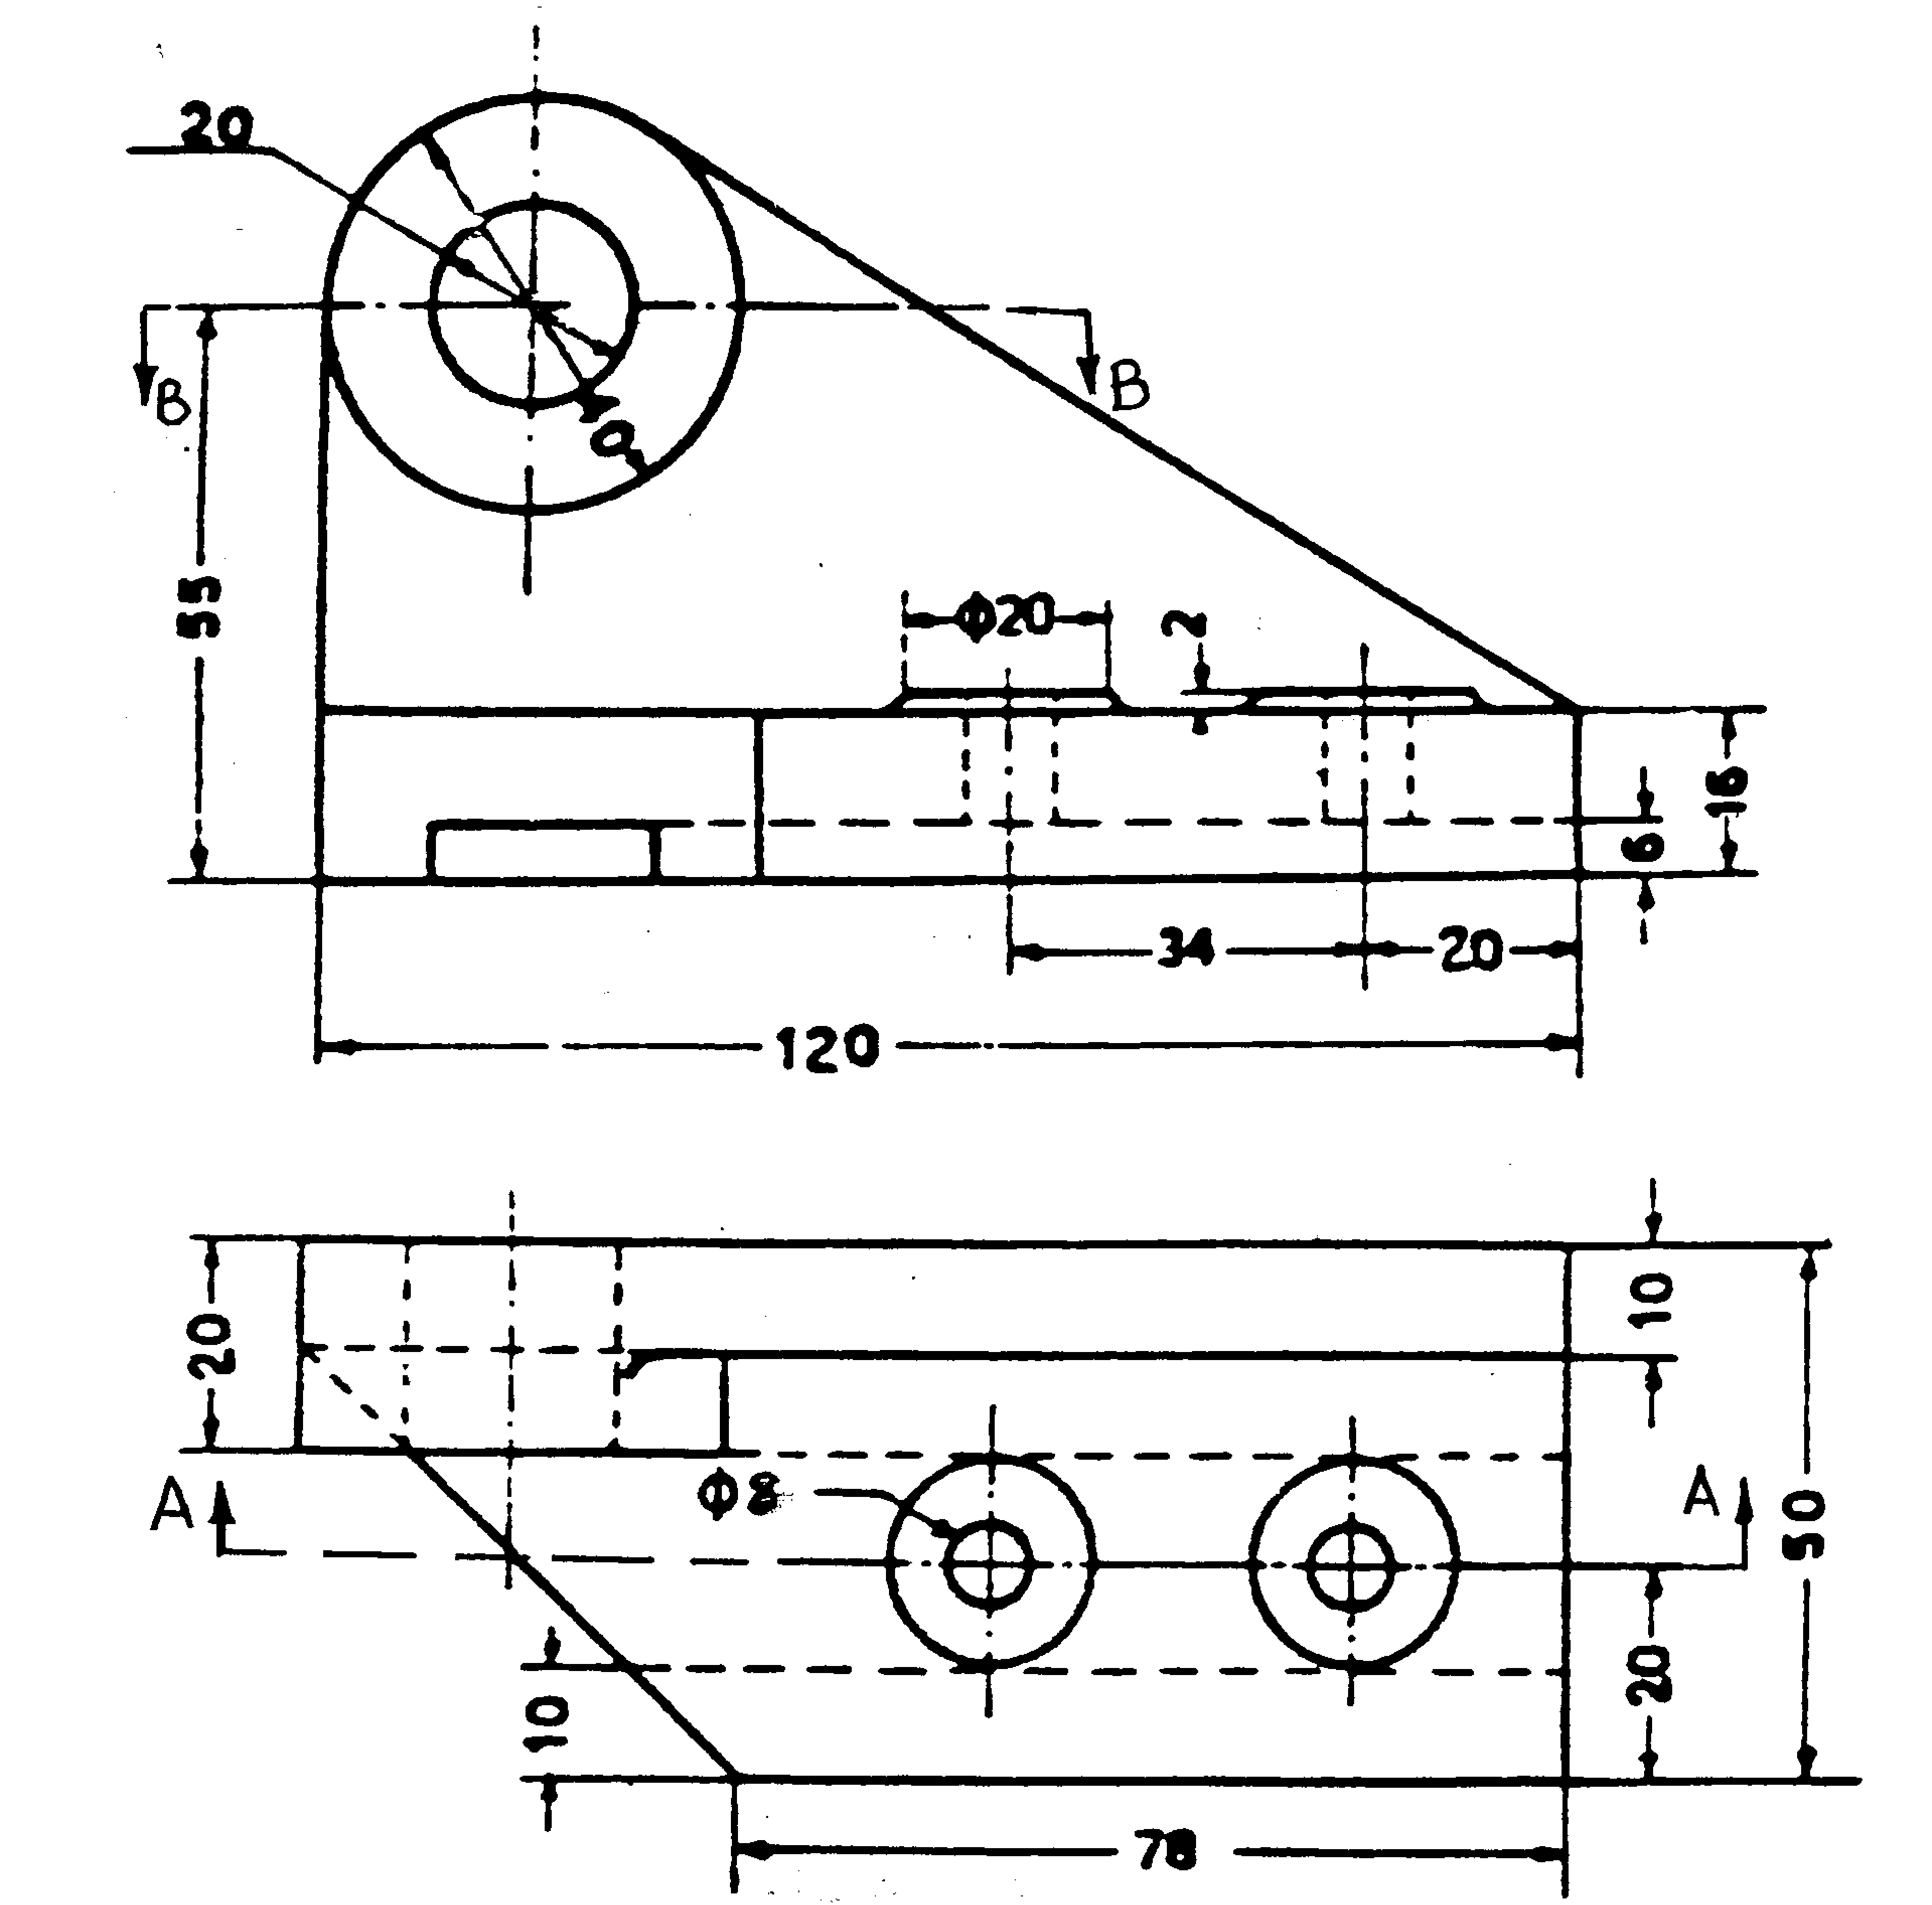
13. Drawing of a sectional plan and side view of a Bearing pricket.
A
A
A
A
B
B
B
B
Prof. Dr. Mohamed Omar Mousa March 2006

