Slide 1
PROJECTION - 5

Slide 2
Solved Problem (6)
5
8
12
13
9
1
2
3
4
7
11
10
9
6
1
12
13
2

Slide 3
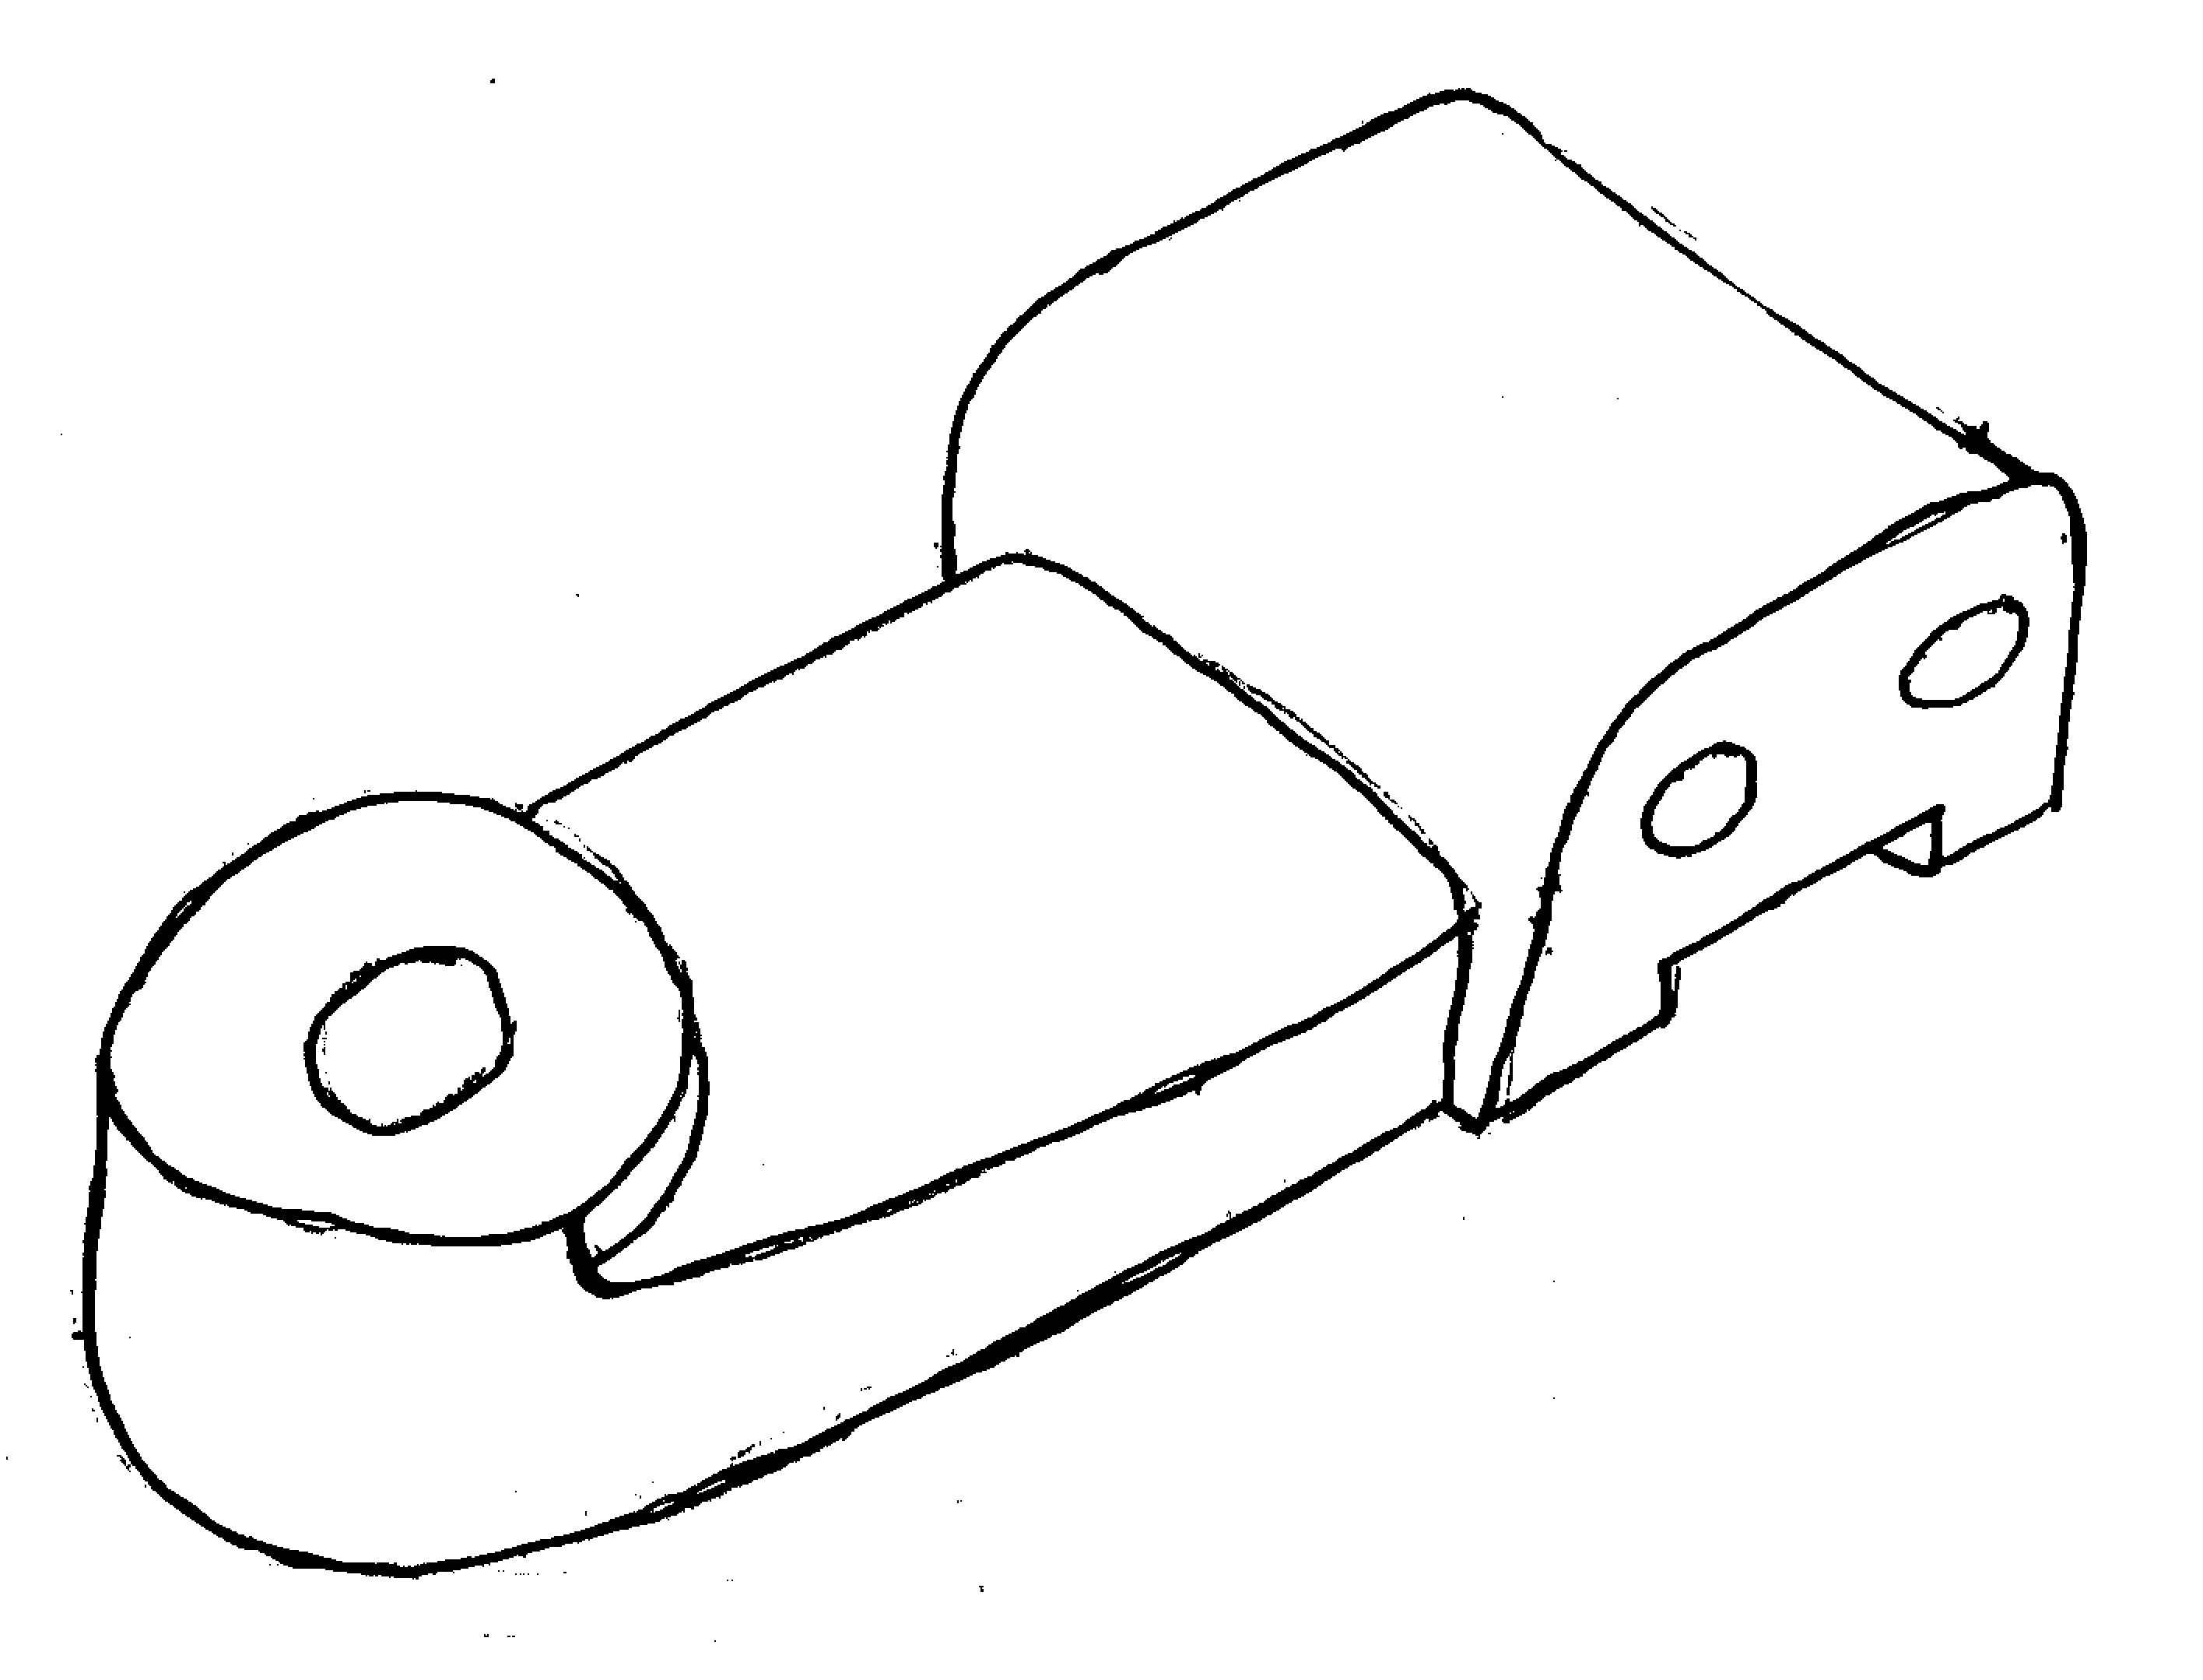
5
5
12
13
12,13
8
8
9
36
9
1
2
3,4
7
11
10
6
1,2
3
4
48
7
72
11
10
9
6
1
12
13
2

Slide 4
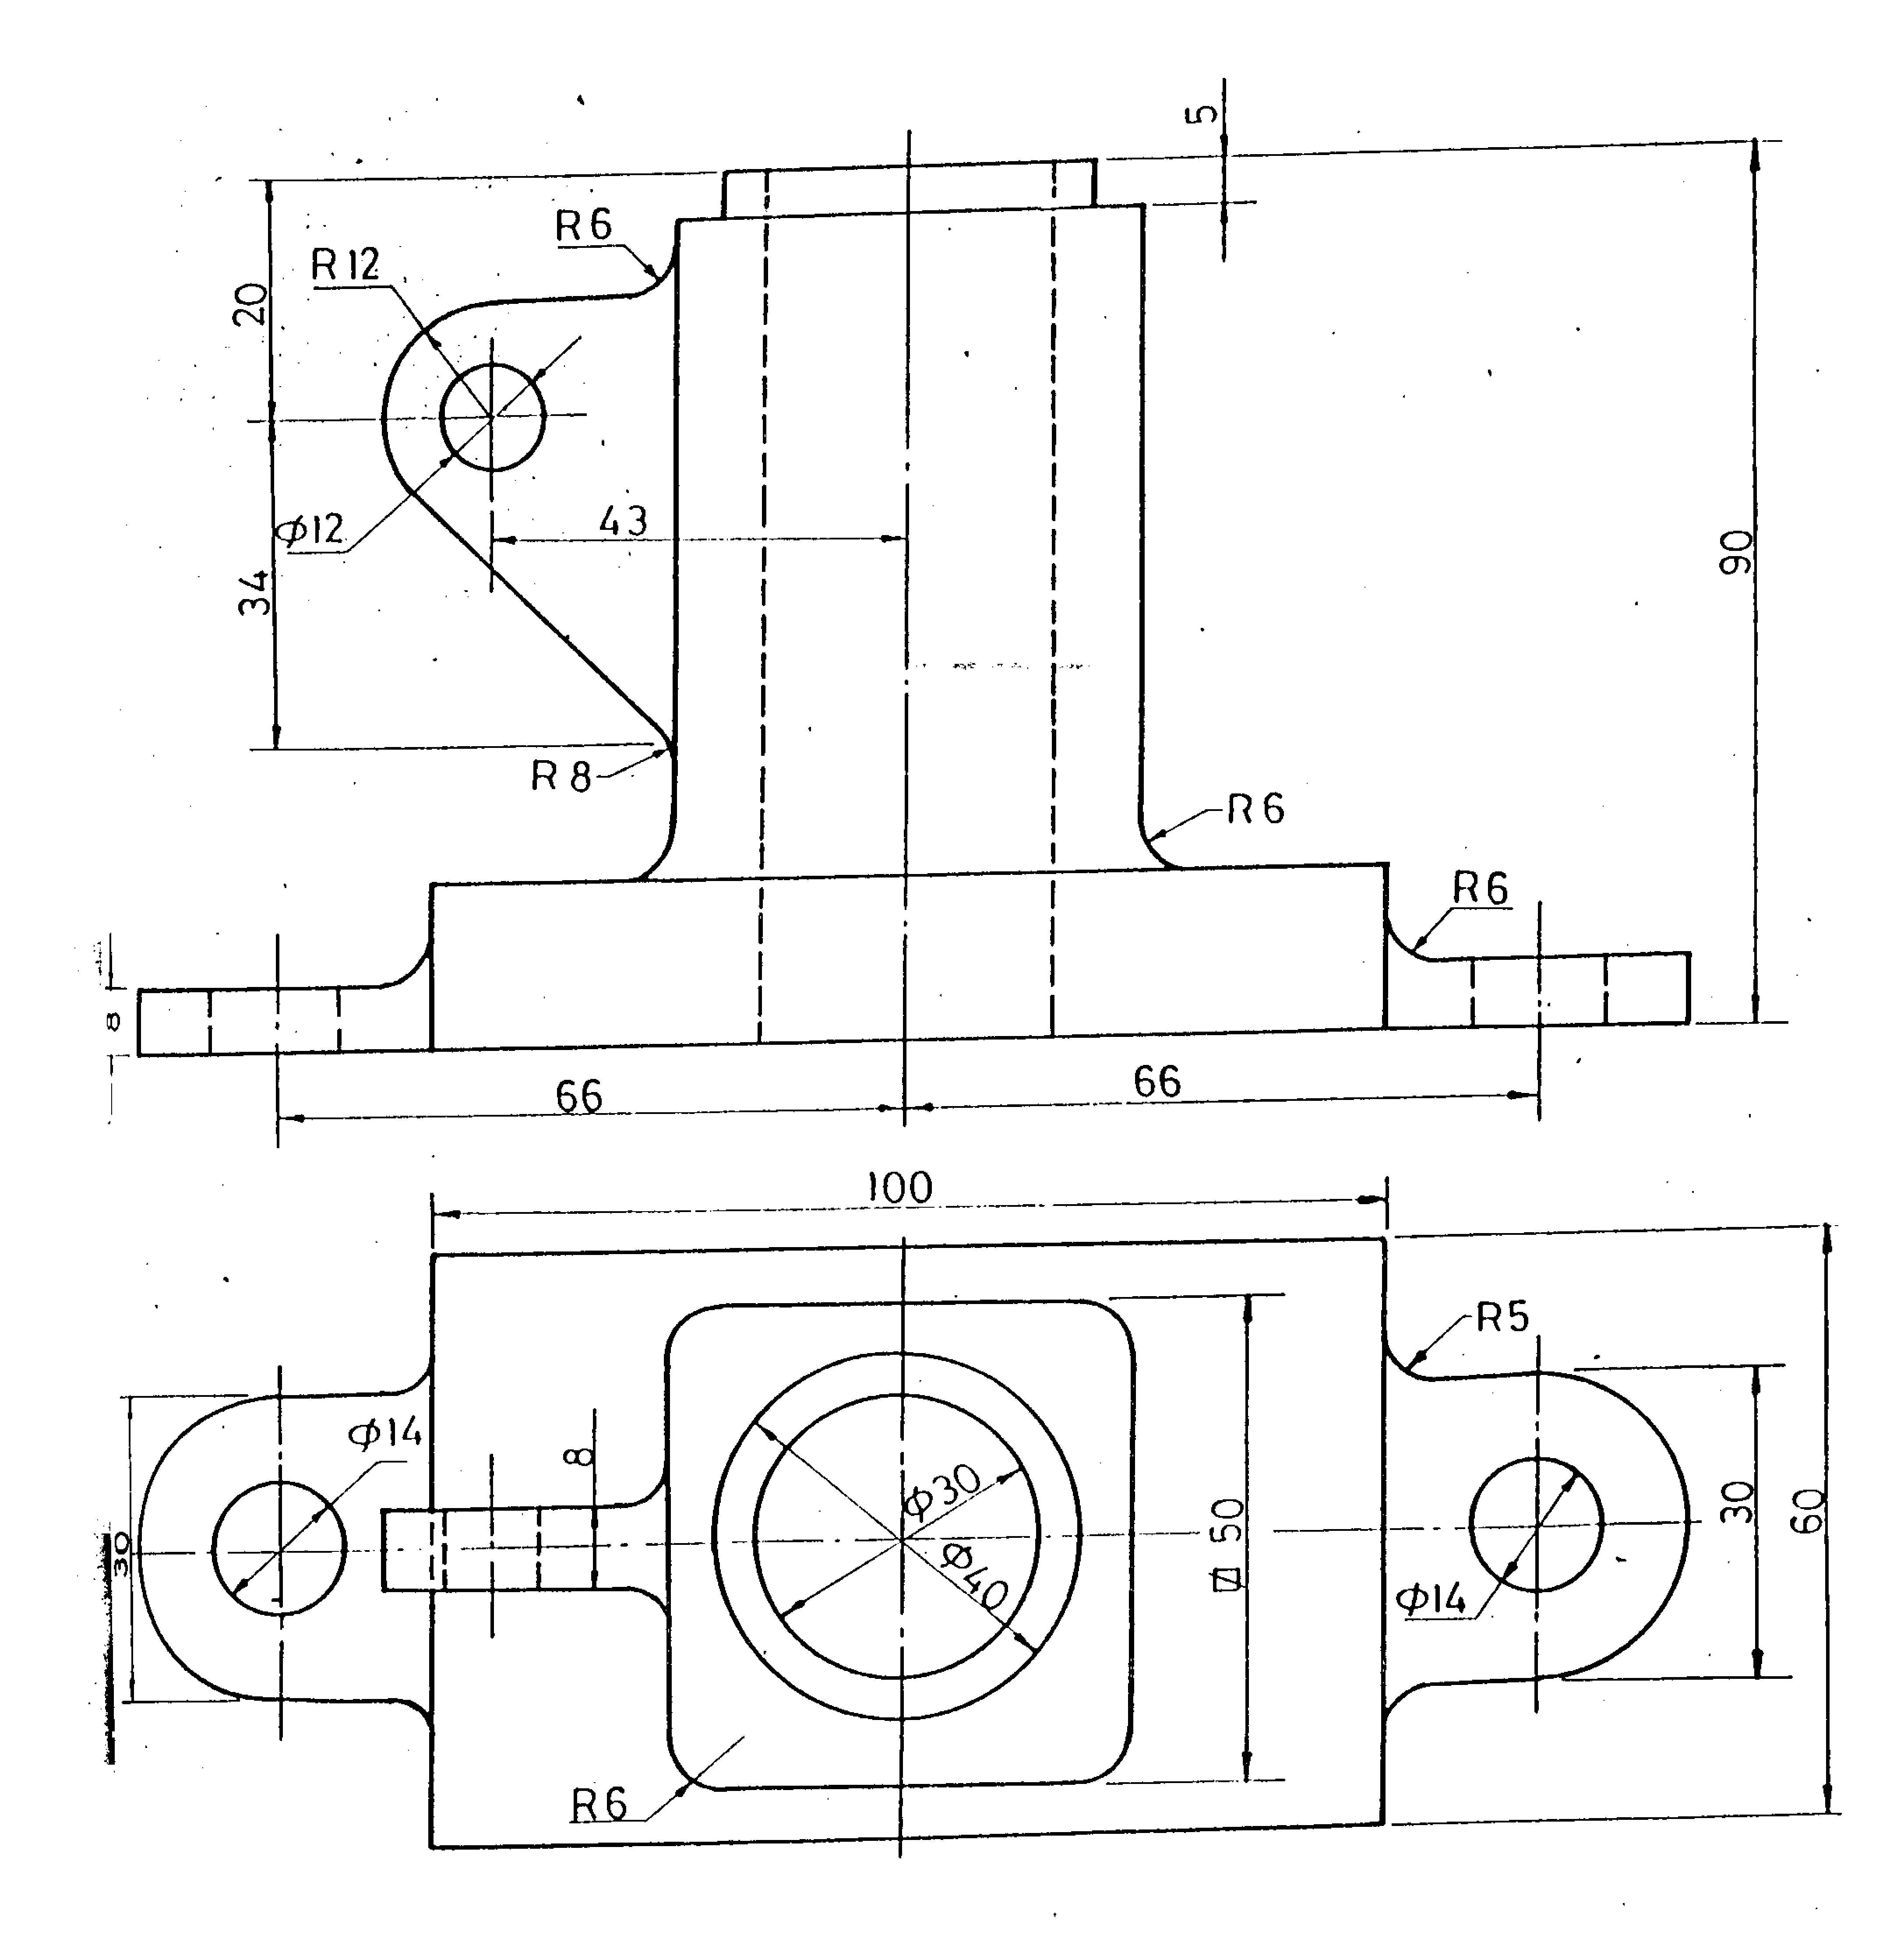
Solved Problem (8)
7
6
11
10
5
9
9”
8”
8
3
4
8
6
8”
10
7
9”
9
11
5
1
2

Slide 5
7
6
6
5
7
11
11
10
5
10
9
9”
8
8”
9
8
3,4
1,2
4
60
3
8
6
8”
10
7
9”
9
11
5
1
2

